Slide 1
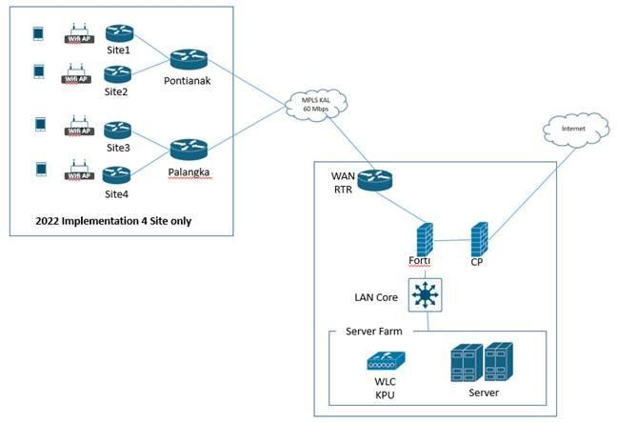
Change Request Form
Date Raised | 31 May 2022
Business Group | KPU
Summary of Change | Request for setup Connection For KPU - Connected Plantation (CP) Application
Full Details of Change | Setup,setting and installation for WLC, Access point and Switch Setup VLAN for Mobile devices, AP and Switch to Connect to CP Apps Detail IP : Topology
No | Device Model | Qt y | Hostname | Management IP | Gateway | Location
1 | Cisco Catalyst 9800-L Wireless Controller | 1 | JKTIDWLC-C1 | 172.18.3.9 | 17.18.3.14 | DC jakarta
2 | Cisco Catalyst 1000 Switch | 2 | SWIDKALKHC-CP01 | 172.18.105.252 | 172.18.105.254 | KHC Kalbar
 |  |  | SWIDKALKKC-CP01 | 172.18.100.252 | 172.18.100.254 | KKC Kalteng
N o | Function | VLAN Name | VLAN ID | Network | Subnet Mask | Usable IP Range | Gateway | DHCP Server | Location
1 | VLAN Management Switch |  | 1 | 172.18.105.0 / 24 | 255.255.255.0 | 172.18.105.252 | 172.18.105.25 4 | static | KHC Kalbar
 | VLAN Management Switch |  | 1 | 172.18.100.0 / 24 | 255.255.255.0 | 172.18.100.252 | 172.18.100.25 4 | static | KKC Kalteng
2 | VLAN Management Wireless Controller | WLC-KPU | 335 | 172.18.3.8 / 29 | 255.255.255.248 | 172.18.3.9 - 172.18.3.14 | 172.18.3.14 | static | DC Jakarta
3 | VLAN Management Access Point |  | 1 | 172.18.105.0 / 24 | 255.255.255.0 | 172.18.105.253 | 172.18.105.25 4 | static | KHC Kalbar
 | VLAN Management Access Point |  | 1 | 172.18.100.0 / 24 | 255.255.255.0 | 172.18.100.253 | 172.18.100.25 4 | static | KKC Kalteng
4 | (VLAN SSID) | AAG-KHC | 336 | 172.18.8.0 /26 | 255.255.255.192 | 172.18.8.1 - 172.18.8.62 | 172.18.8.62 | DHCP | KHC Kalbar
5 | (VLAN SSID) | KDP-KKC | 337 | 172.18.8.64 /26 | 255.255.255.192 | 172.18.8.65 - 172.18.8.126 | 172.18.8126 | DHCP | KKC Kalteng

Slide 2



Change Request Form
Reason for Change/ Intended Business Benefit | to support business needs for fast data and reports
Criticality |  Low |  Medium | √ | High
Implementation Date | Jun 2022
Requester / BU Head (Key User for IT application changes) | Name | : Susanto
 | Phone | : 081345228532 |  | Email | : Susanto@agrilestari.com
 | Signature :
 | Date | : 31 Mei 2022
BG Approver (BG Head/System Owner) | Name | : Gou Seng Kwe |  | Name | :
 | Signature : |  |  | Signature :
 | Date | : 31 Mei 2022 |  | Date | :

